Slide 1
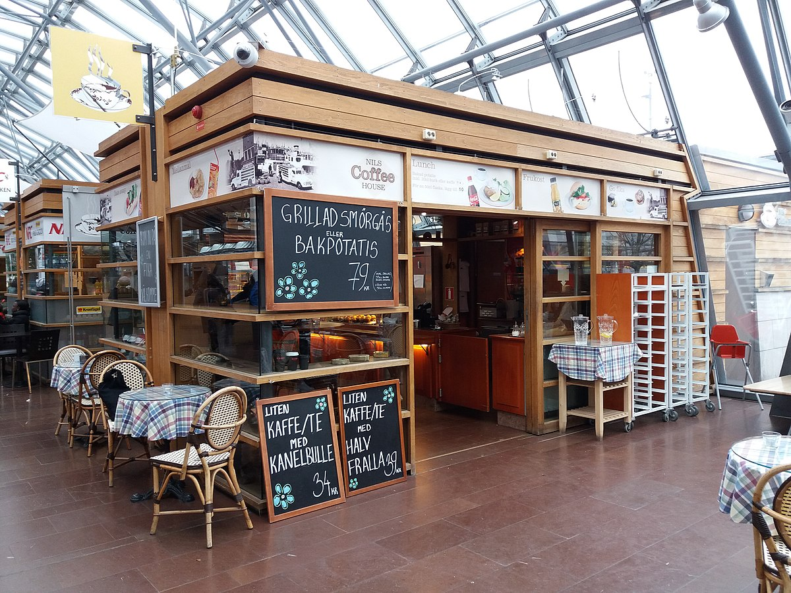
Apni Dukan
Team: Anmol, Ritik, Swarup
Institute: Thapar University

Slide 2

PROBLEM
STATEMENT
“
Formulate a solution for small to medium retailers to manage inventory per daily demand using historical store sales trends | provide support in location expansion strategy
“

Slide 3

FACTS BUSINESS CHALLENGE
Shop-keepers either order more or lesser quantity to meet regular demand
Difficult for retailers to expand the business due to less availability of details
Shopkeepers face challenges with procurement due to the COVID-19 unprecedented time
It is tougher to move to online platform due to technical challenges
Small retailers are able to procure essential items but often buying the incorrect types, wasted inventory and un-necessary surplus

Slide 4



BUSINESS MODEL
The working of ‘Apni Dukan’ is based on 2 simple models:
For essential items like Dairy and bakery products, ‘Apni-Dukandar’ can maintain the inventory by looking at demand forecast and existing suppliers.
For other categories, which are larger part of the business like pulses, rice. ‘ApniDukan’ makes the effort to understand the potential need, and help the ‘Apni-Dukandar’ to meet the changing demands. This is done through a web and apps platform, which the team has started investing on.
SATISFYING SERVICES
BEING ONE TIME AND SCHEDULE

Slide 5

HOW EXACTLY IT WORKS
1
2
3
Goes through previous trends
Calculate the amount required using Machine Learning
Displays the details

Slide 6

THANK YOU FOR
READING

